Slide 1
REIT Portfolio Analysis:
Time Series Modeling
Andrew Cole

Slide 2
Overview
Domain Information - Real Estate Investment Trusts
Data Gathering & Exploration
Target Measure
External Influences
Model Performance

Slide 3
Real Estate Investment Trusts
Low-cost & liquid asset class
Equity REITS & Mortgage REITS
Equity = ownership of property
Mortgage = Income from mortgage financing
90% of income must be paid to investors via dividends

Slide 4
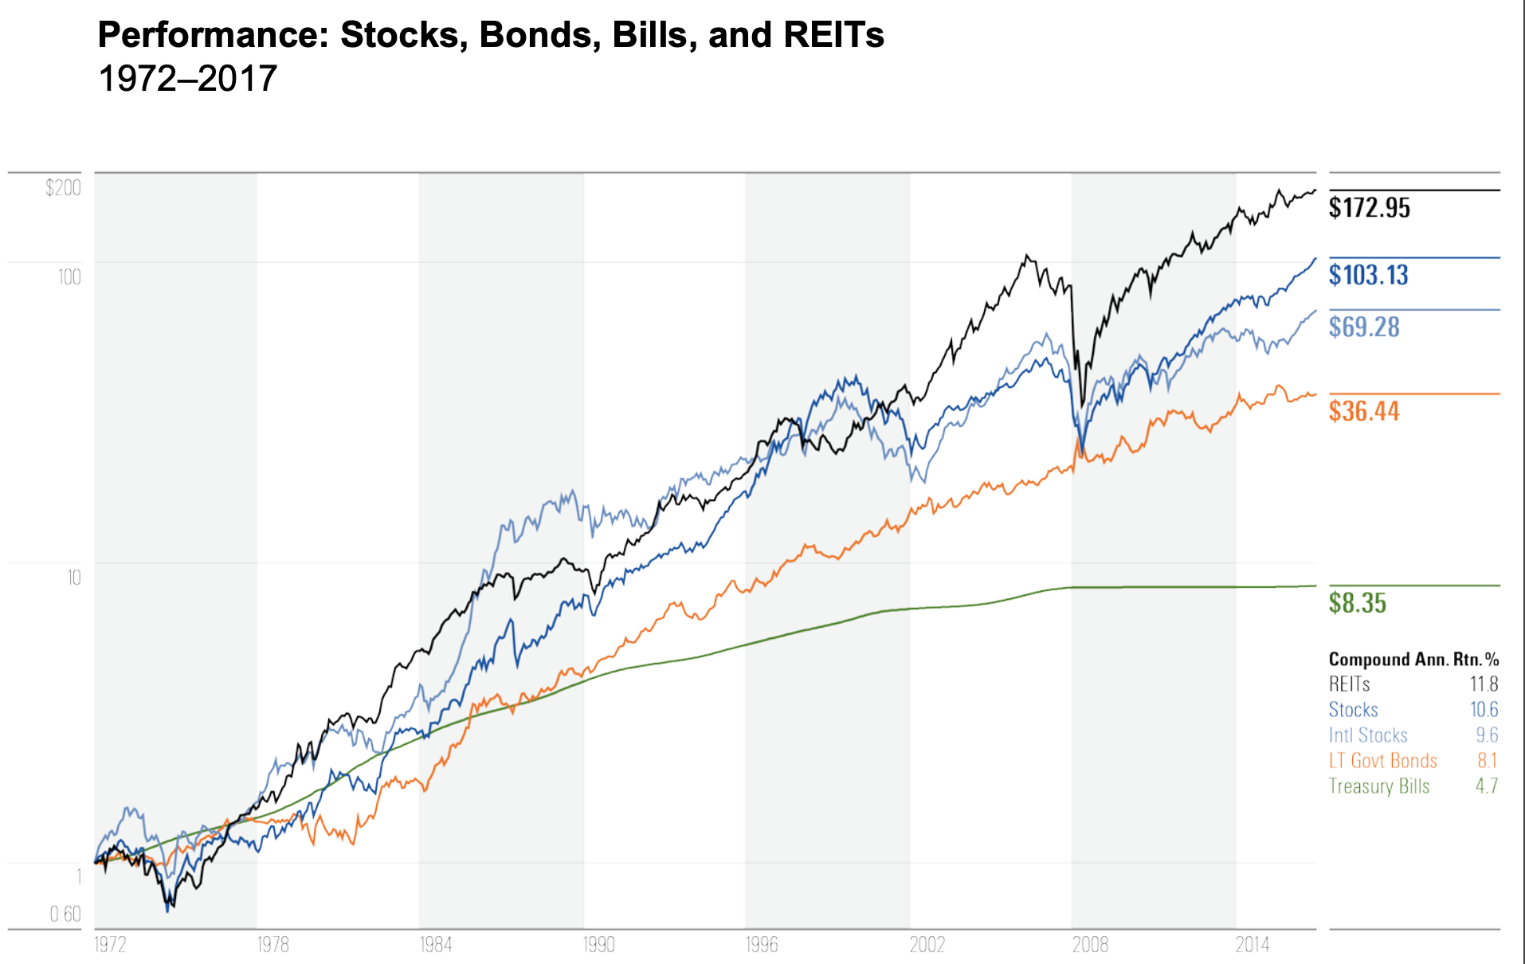
Source: MorningStar

Slide 5

Target Variables
8 REIT Portfolio
Data Time Period: 2000 - 2020
5026 Daily Entries 240 Monthly Average Entries
Target Variable: Mid Price
(Opening Price + Closing Price)/2

Slide 6
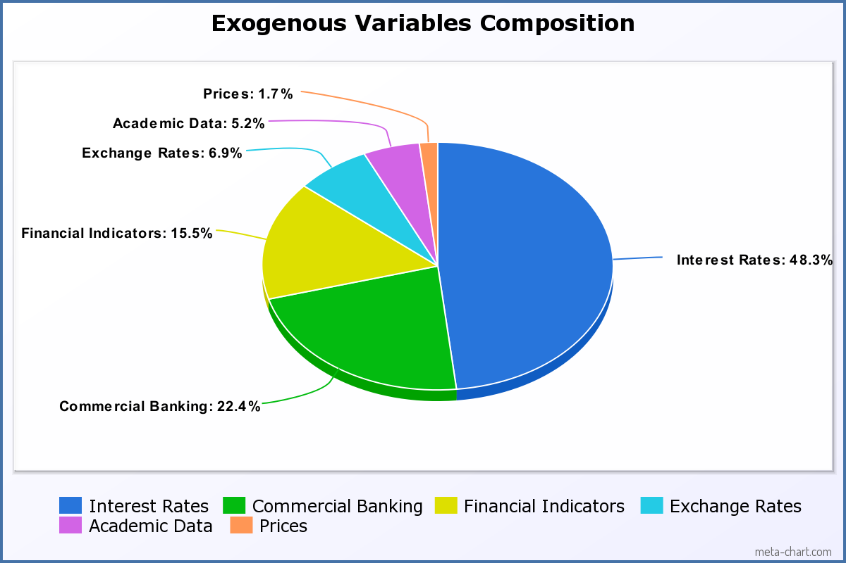
External Influences
58 Exogenous Variables gathered (Source: FRED)
Most important variables selected relative to individual REITs

Slide 7
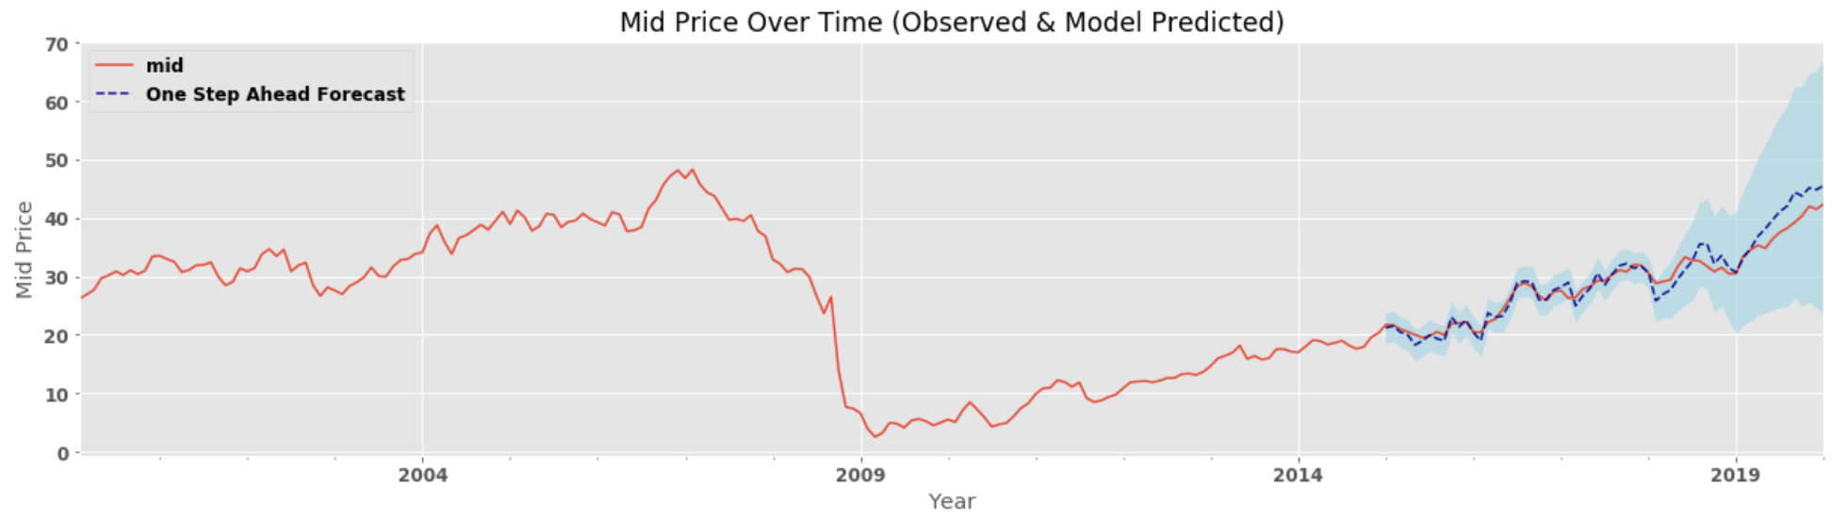
FR Time Series:
Exogenous Variables Examples (18 total):
NASDAQ Composite Index
Wilshire US REIT Total Market Index
Total Assets, All Commercial Banks
Borrowings, All Commercial banks

Slide 8
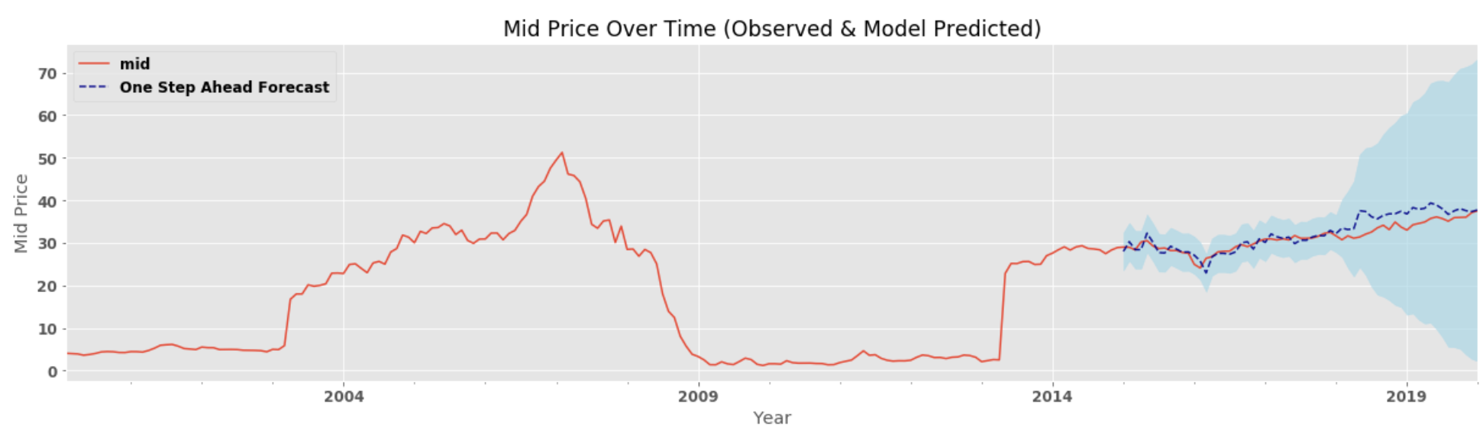
BXMT Time Series:
Exogenous Variables Examples (6 total):
Commercial & Industrial Loans, Domestic Chartered Commercial Banks
Commercial & Industrial Loans, All Commercial Banks
Consumer Loans, All Commercial Banks
Economic Policy Uncertainty Index (US)

Slide 9
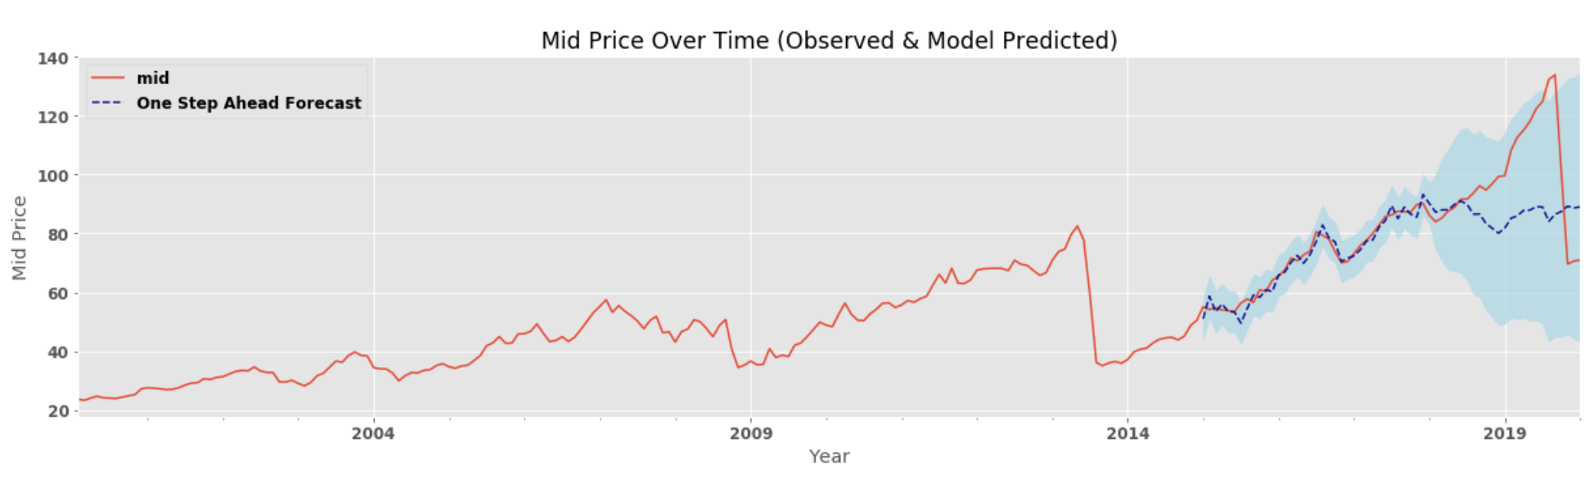
ELS Time Series:
Exogenous Variables Examples (8 total):
Real Estate Loans: Residential Real Estate-Domestic Commercial Banks
Commercial and Industrial Loans, Domestically Chartered Commercial Banks
Econ Policy Uncertainty Index (US)
CBOE DJIA Volatility Index

Slide 10
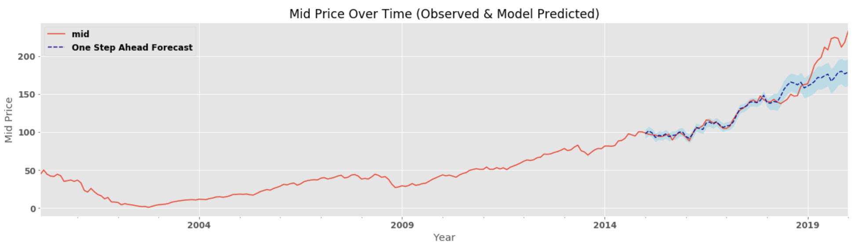
AMT Time Series:
Exogenous Variables Examples (8 total):
Real Estate Loans: Residential Real Estate-Domestic Commercial Banks
Commercial and Industrial Loans, Domestically Chartered Commercial Banks
Econ Policy Uncertainty Index (US)
CBOE DJIA Volatility Index

Slide 11
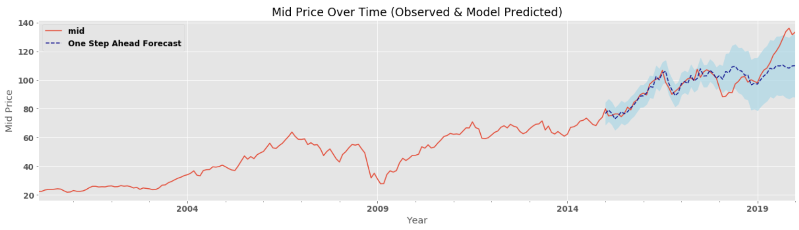
MAA Time Series:
Exogenous Variables Examples (4 total):
Moody’s Seasoned AAA Corporate Bond Yield
Price Pressures Measure
10-Year Treasury Constant Maturity Minus Fed Funds Rate
CBOE DJIA Volatility Index

Slide 12
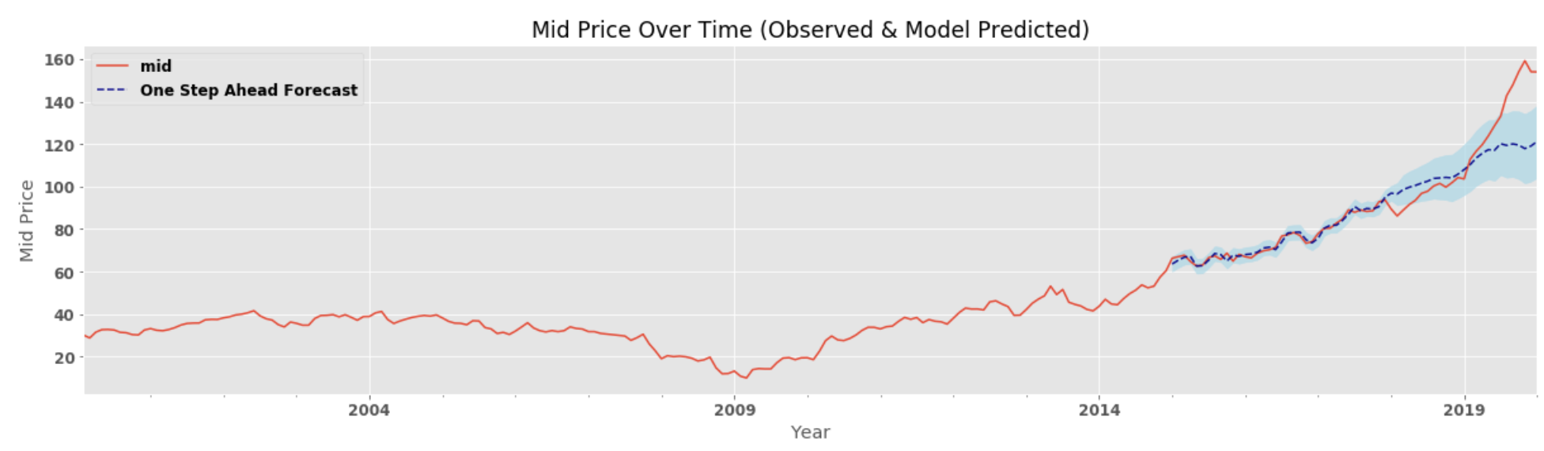
SUI Time Series:
Exogenous Variables Examples (10 total):
St. Louis Fed Financial Stress Index
Bank Prime Loan Rate
China/US Foreign Exchange Rate
Chicago Fed Financial Conditions Index

Slide 13
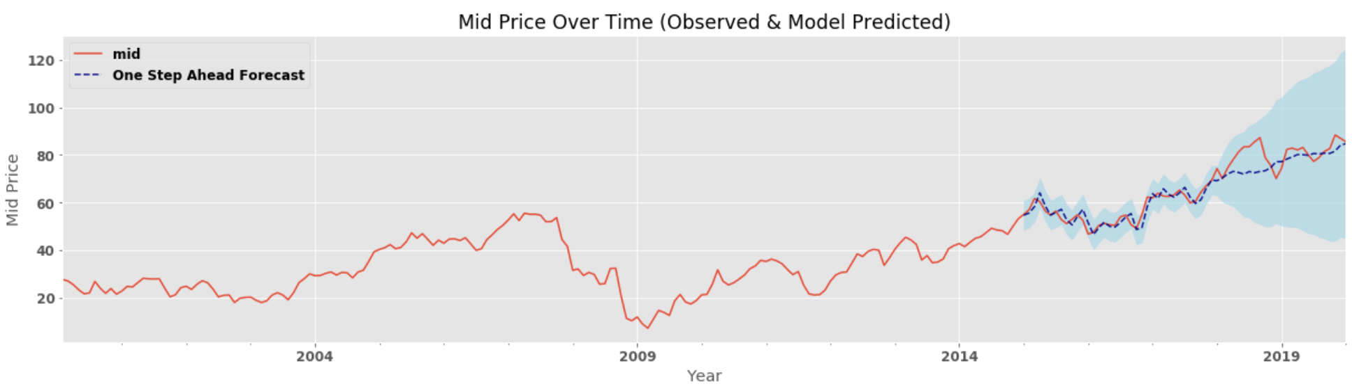
RHP Time Series:
Exogenous Variable Examples (4 Total):
1-Week LIBOR (Euro-Based)
10-Year Treasury Constant Maturity Minus 2-Year Treasury Constant Maturity
Price Pressures Measure
3-month AA Nonfinancial Commercial Paper Rate

Slide 14
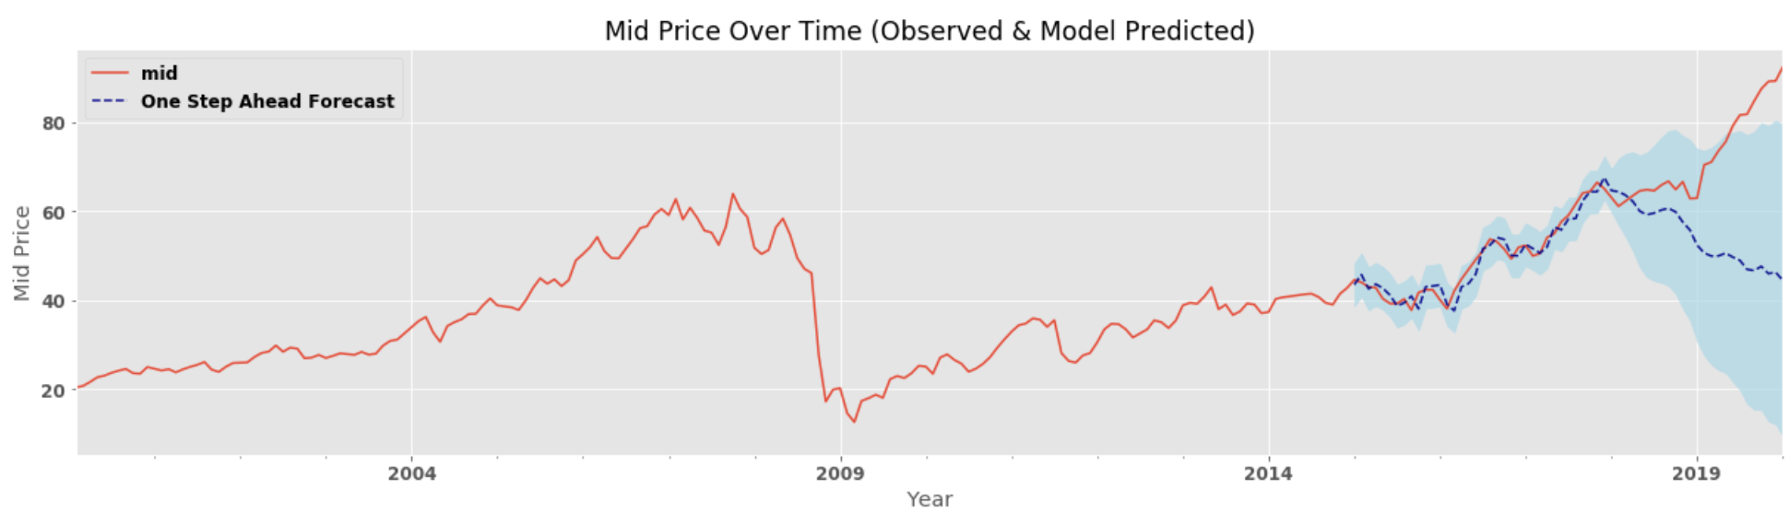
PLD Time Series:
Exogenous Variables Examples (5 total):
Commercial & Industrial Loans, Domestic Commercial Banks
Real Estate Loans, All Commercial Banks
Commercial & Industrial Loans, All Commercial Banks
Cash Assets, Domestic Chartered Commercial Banks

